Slide 1
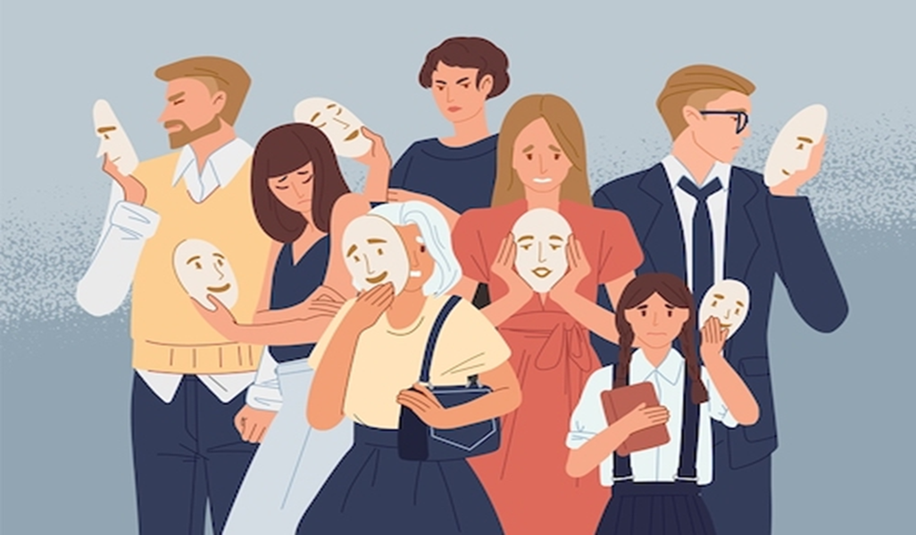
personality
Miss Aqsa Fayyaz
Lecture- 07 Spring-2022

Slide 2
Learning outcomes
The students would be able to understand aspects of their personalities.
Understanding the personality on 5 factors model of personality.
Understanding personality in regards to ego defense mechanisms.
Learning about Real self and Ideal self

Slide 3

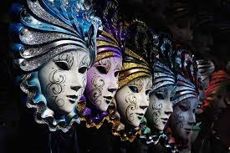
PERSONALITY
The word personality itself stems from the Latin word persona, which refers to a theatrical mask worn by performers in order to either project different roles or disguise their identities.
It is believed that personality arises remains fairly consistent throughout life.

Slide 4
Definition:
Personality is the characteristic patterns of thoughts, feelings, and behaviors that make a person unique.

Slide 5
The born versus made/
nature versus nurture debate
Personal
character traits
Culture
of society
INFLUENCES ON
INDIVIDUALS
antecedent
influences
Situational
factors
From: Burns, 2001

Slide 6
What It Is and Why You Should Care.
It’s everything about you that makes you what you are—a unique individual who is different, in large and small ways, from everybody else.
Everything you have accomplished to this date is determined by your personality.
Our personality can limit or expand our options and choices in life.

Slide 7
How often have you said that someone has a terrific personality?
You also know people you describe as having a terrible personality.

Slide 8

Write down as many adjectives as you can think of to describe what you are really like?
Not how you would like to be, or what you want your teachers or parents or Facebook friends to think you are like—but the real you.

Slide 9
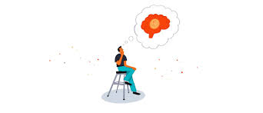
Ways of Looking at Personality
We use it a lot when we are describing other people and ourselves.
When we are using “I” to describe ourselves
How others See/describe Us
Stable and Predictable Characteristics
Unique Characteristics

Slide 10
DISCSSION
Are You the Same Person Online?
How Does the Social Media Influence Our Personality?
How Does Our Personality Influence Our Use of Social Media?
What about the personalities of people who engage in Internet trolling— deliberately hurting, harassing, and upsetting others by posting hateful, inflammatory, and derogatory comments about them. What are they like?

Slide 11
Theories of personalities
Psychoanalysis theory
Sigmund Freud
Humanistic theories
Carl Rogers

Slide 12
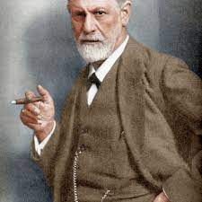
PSYCHOANALYSIS: Sigmund Freud
Turn your eyes inward, look into your own depths, learn to first know yourself.

Slide 13
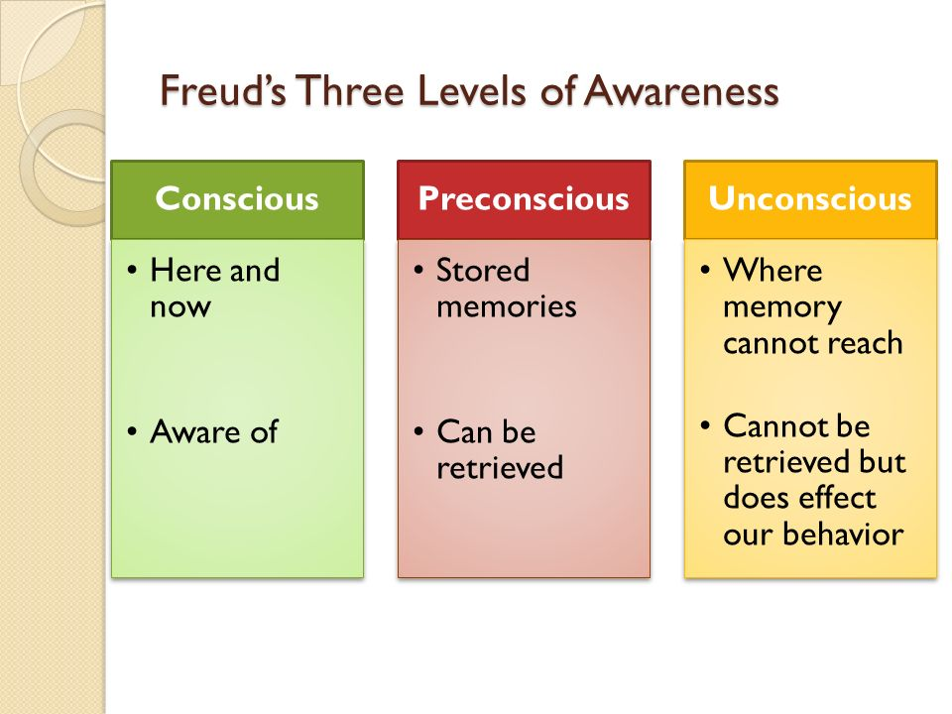
SIGMUND FREUD- Psychoanalysis
Sigmund Freud (6 May 1856 – 23 September 1939) was an Austrian neurologist who became known as the founding father of psychoanalysis.
He Proposed the first complete theory of personality.
Sigmund Freud’s psychoanalytic theory grew out of his therapeutic work with clients and emphasized the importance of the unconscious.
Freud described three levels of awareness.

Slide 14
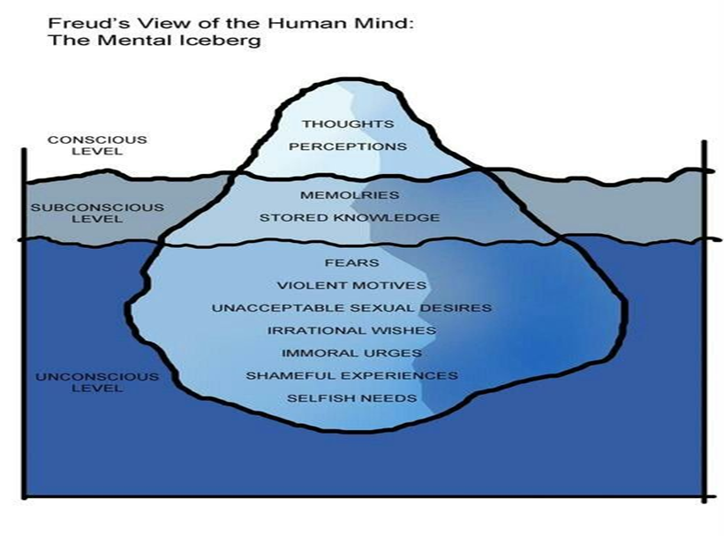
Freud believed that events in our childhood have a great influence on our adult lives, shaping our personality.
For example, anxiety originating from traumatic experiences in a person's past is hidden from consciousness, and may cause problems during adulthood.
Freud believed that most of the important personality processes occur below the level of conscious awareness.
Like an iceberg, the most important part of the mind is the part you cannot see. Our feelings, motives and decisions are actually powerfully influenced by our past experiences, and stored in the unconscious.

Slide 15
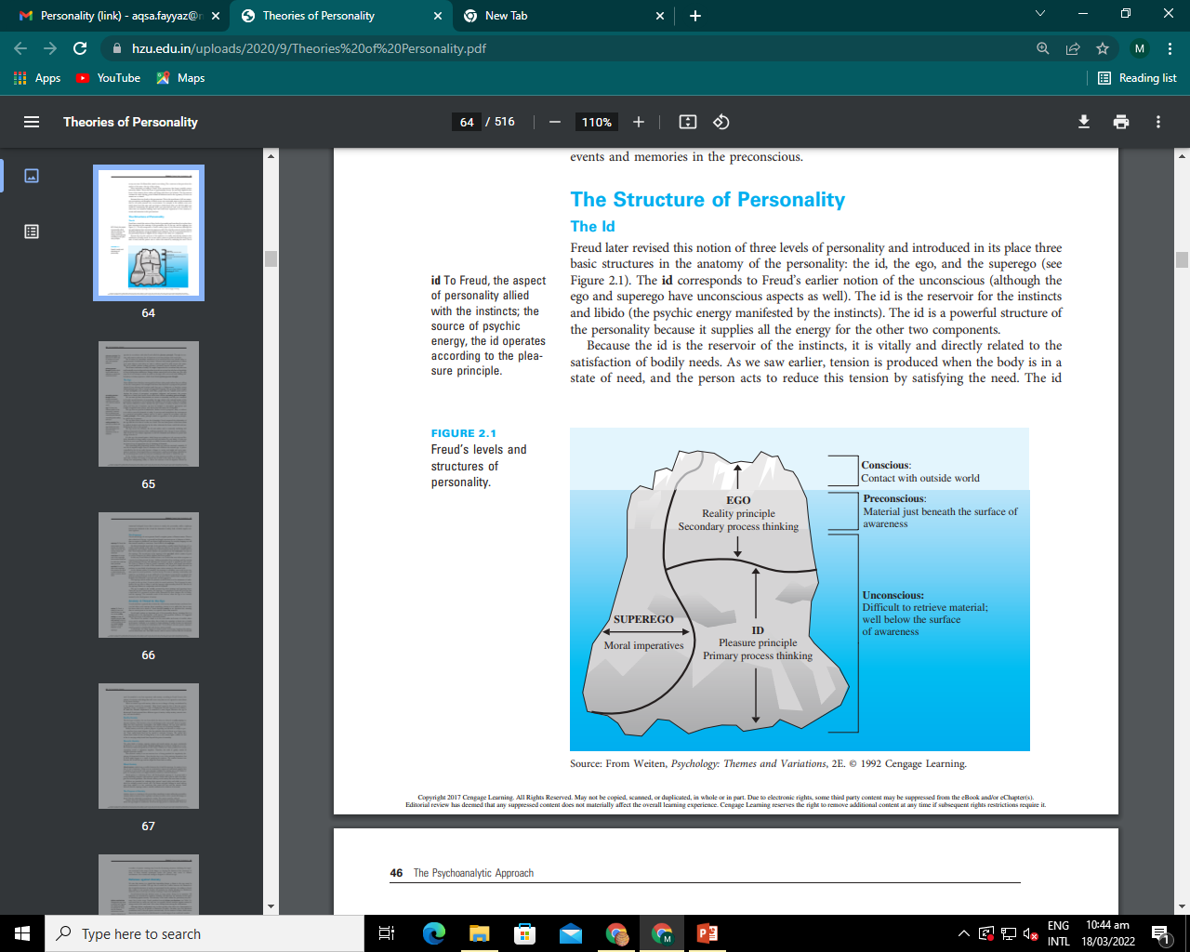

Slide 16
Freud divided personality into three structures: the id, the ego, and the superego
He believed that personality is constantly in conflict due to these structures.

Slide 17
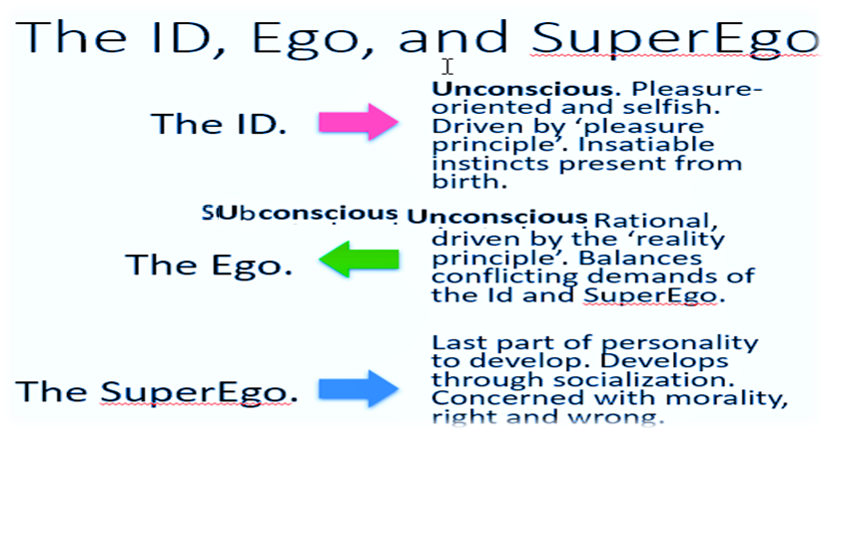
Structure of personality
Freud divided personality into three structures: the id, the ego, and the superego

Slide 18
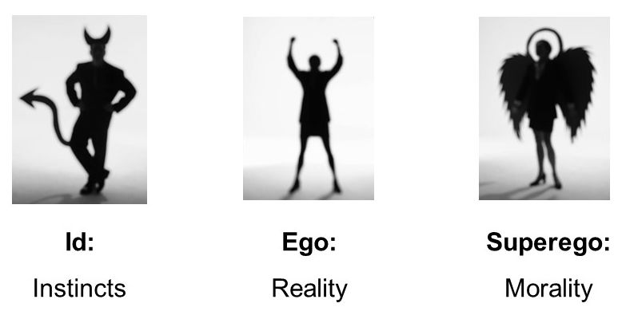
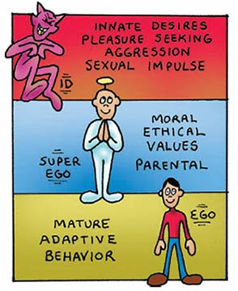
The Structure of Personality
The Id – Reservoir of Psychic Energy
Most primitive part of the mind; what we are born with.
Source of all drives and urges
Operates according to the pleasure principle .
In other words, the id wants whatever feels good at the time, with no consideration for the reality of the situation.
The id seeks instant gratification for our wants and needs.
Example: Hamnah was thirsty. Rather than waiting for the server to refill her glass of water, she reached across the table and drank from Saad's water glass, much to his surprise.

Slide 19
The Structure of Personality
The Ego- Executive of Personality
Within the next three years, as the child interacts more and more with the world, the second part of the personality begins to develop. Freud called this part the Ego.
Operates according to the reality principle
Mediates between id, superego, and environment
Example: Hamnah was thirsty. However, she knew that her server would be back soon to refill her water glass, so she waited until then to get a drink, even though she really just wanted to drink from Saad's glass.

Slide 20
The Structure of Personality
The Superego- Upholder of Values and Ideals
The part of the mind that internalizes the values, morals /ethics, and ideals of society
Develops around age 5 develops due to the moral and ethical restraints placed on us by our caregivers.
Many equate the superego with the conscience as it dictates our belief of right and wrong.
Example: Hamnah was thirsty, she’ll think drinking water from someone’s glass without permission is wrong.

Slide 21
Even though the superego and the ego may reach the same decision about something,
The superego's reason for that decision is based more on moral values, while the ego's decision is based more on what others will think or what the consequences of an action could be on the individual.

Slide 22
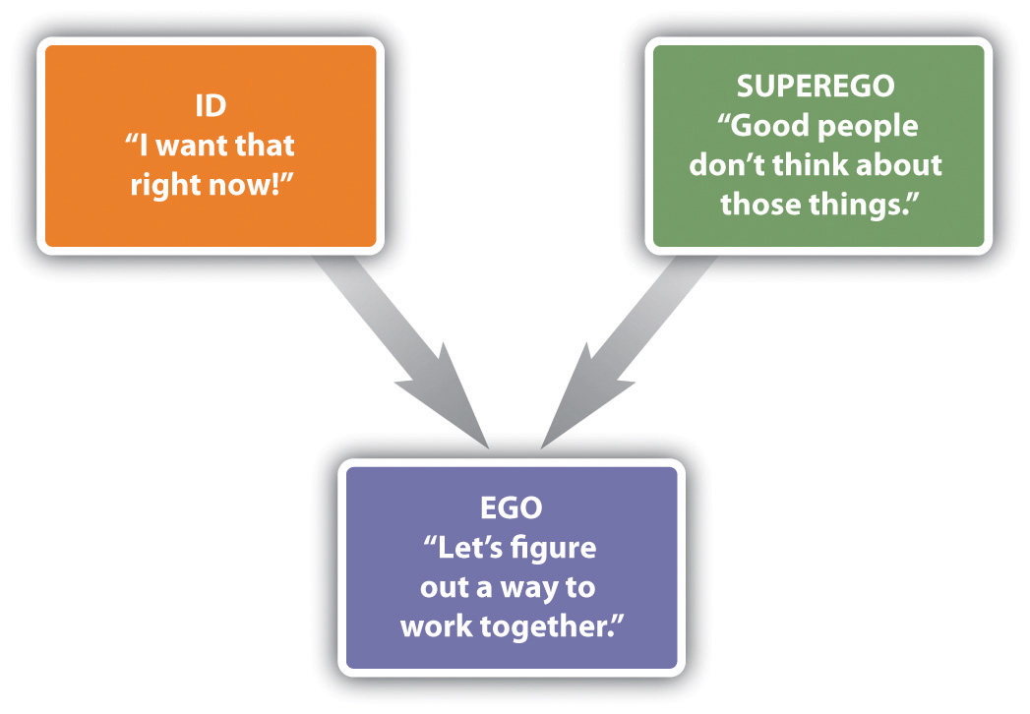
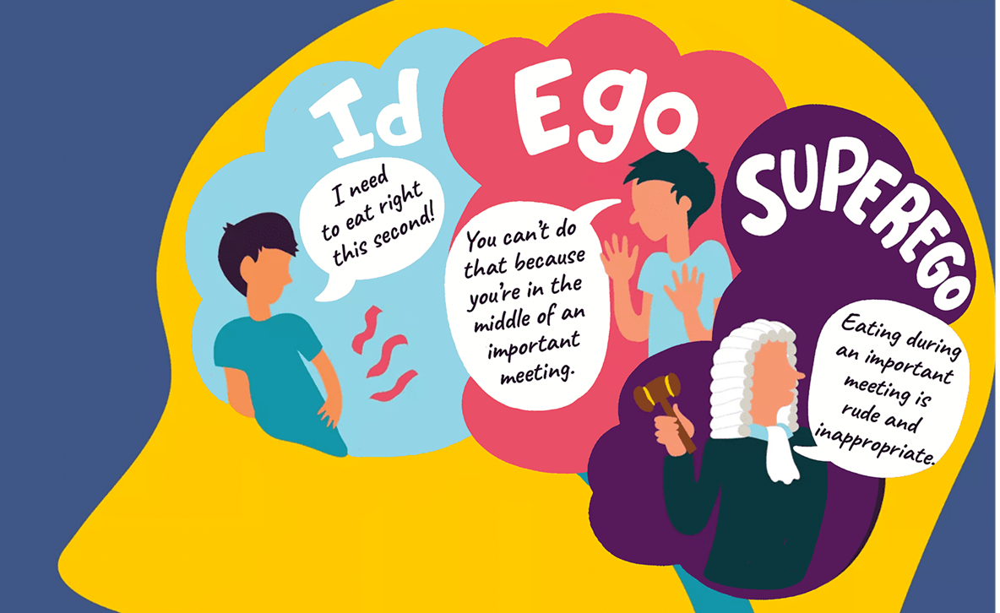
examples
MEDIATOR

Slide 23
The Structure of Personality
In a healthy person, according to Freud, the ego is the strongest so that it can satisfy the needs of the id, not upset the superego, and still take into consideration the reality of every situation.
If the id gets too strong, impulses and self gratification take over the person's life. For example: In criminals they have Selfishishness
If the superego becomes to strong, the person would be driven by rigid morals, would be judgmental and unbending in his or her interactions with the world

Slide 24
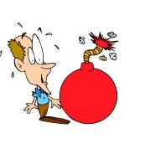
Defence mechanisms
Is an unconscious psychological operation that functions to protect a person from anxiety-producing thoughts and feelings related to internal conflicts and outer stressors.
These are the ways of dealing with difficult feelings which your mind uses.

Slide 25
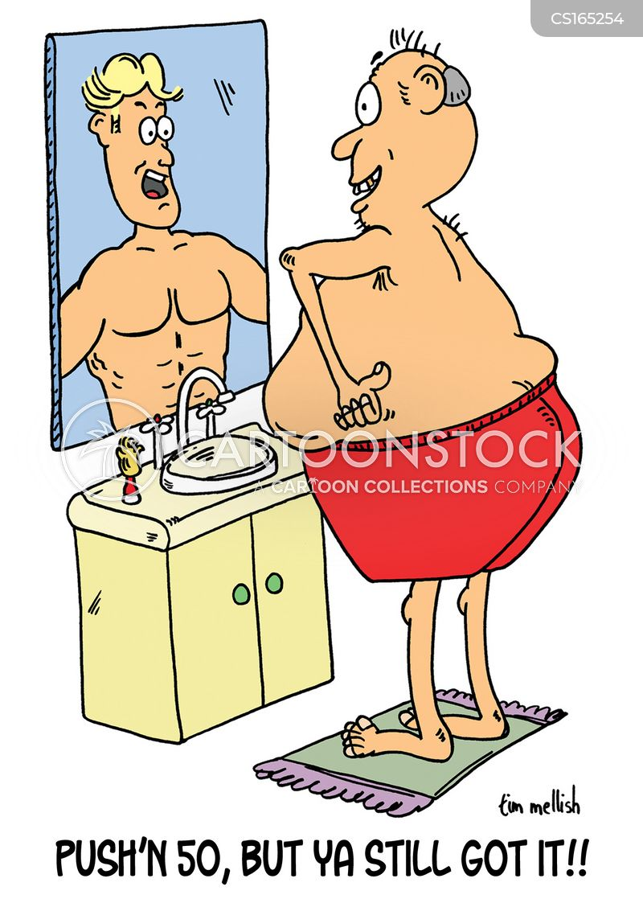
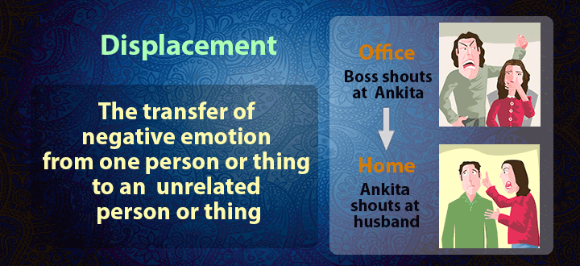
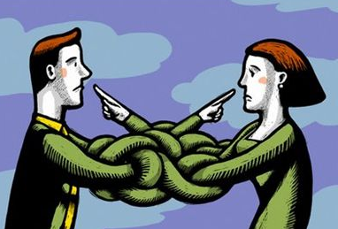
DENIAL
A refusal to accept reality.
denying that your physician's diagnosis of cancer is incorrect and seeking a second opinion
DISPLACEMENT
Taking out impulse/negative emotions on a less threatening target.
slamming a door instead of hitting as person, yelling at your spouse after an argument with your boss
PROJECTION
Placing one’s own unacceptable thoughts onto others, as if the thoughts belonged to them and not to oneself.
when losing an argument, you state "You're just Stupid"

Slide 26
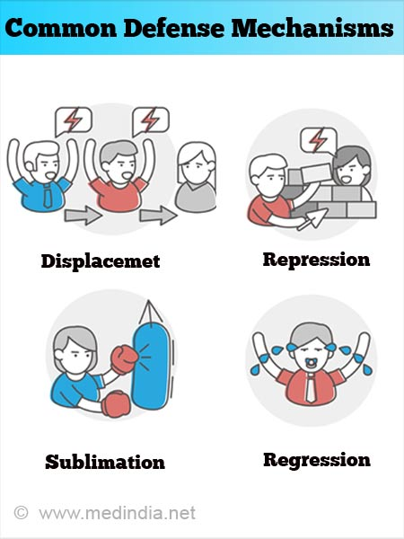
REGRESSION
returning to a previous stage of development/ using previous developmental behaviors when faced with overwhelming stress.
E.g.: sitting in a corner and crying after hearing bad news; throwing a temper tantrum when you don't get your way
E.g.: Reverting to sucking thumb when in stress
REPRESSION
“Pushing” threatening or conflicting events out of conscious memory
E.g.: A man is jealous of his good friend’s success but is unaware of his feeling of jealousy.
Elise, who failed her math exam in board, cannot remember the event at all.
SUBLIMATION
Acting out unacceptable impulses in a socially acceptable way
E.g. A man who has aggressive nature decides to pursue a career
as a boxer.

Slide 27
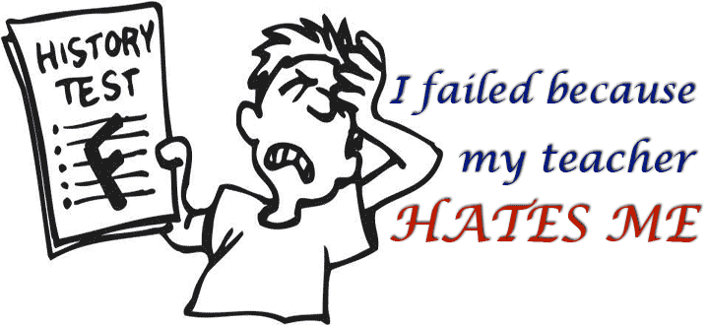
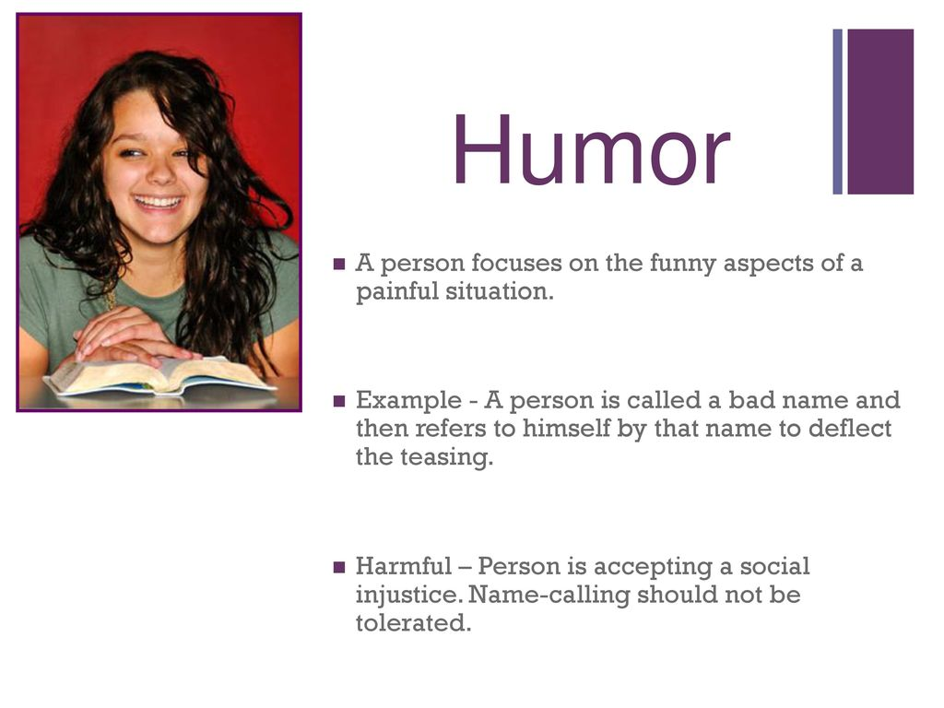
RATIONALIZATION
Making up acceptable excuses for unacceptable behavior.
E.g.. Stating that you failed a test because the teacher doesn’t like you, when the real reason was you didn’t study.
HUMOR
Focusing on the humorous aspects of an uncomfortable or adverse situation.
E.g.. A nervous patients jokes about an upcoming operation.
SUPPRESSION
Voluntary exclusion from awareness, anxiety producing feelings, ideas and situation.
E.g.: A nursing student states, “”I cannot talk about my recent board, please change the topic.

Slide 28
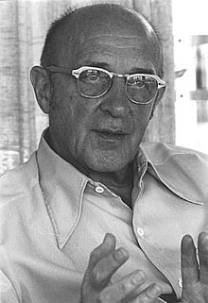
Humanistic approach: CARL ROGER
Pioneer in bringing humanistic approach in counselling.
“The curious paradox is that when I accept myself just as I am, then I can change.”

Slide 29
Carl Rogers
Carl Rogers gave person centered theory which states that every person is unique.
Rogers believed that people are inherently good and creative.
Rogers believed that all people possess an inherent need to grow and achieve their potential.
People are free to choose their own lives and make their own decisions

Slide 30
Main COMPONENTS FOR A PERSONALITY TO GROW
For a person to "grow", they need an environment that provides them with
Genuineness: (being honest, openness and self-disclosure),
Acceptance / unconditional positive regard: (acknowledging feelings, even problems, without passing judgment)
and Empathy: (being listened to and understood).

Slide 31
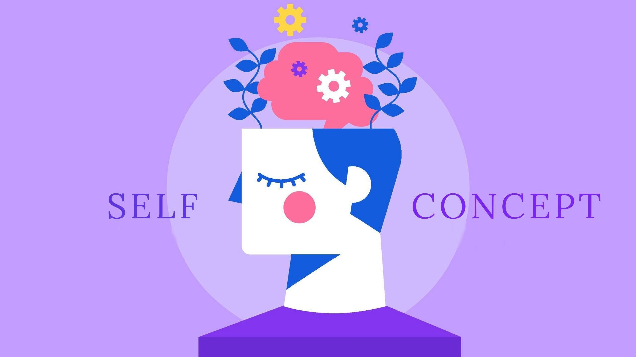
COMPONENTS OF SELF CONCEPT
Self concept: The self-concept is a general term used to refer to how someone thinks about, evaluates or perceives themselves.
One's self-concept is a collection of beliefs about oneself.
It is comprised of real self and ideal self

Slide 32
ACTIVITY (Real self Ideal Self)

Slide 33
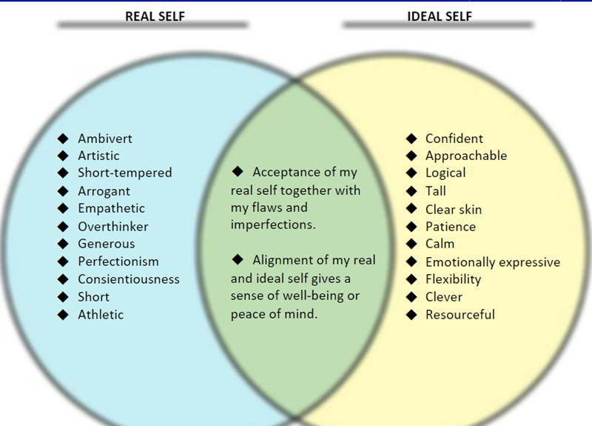
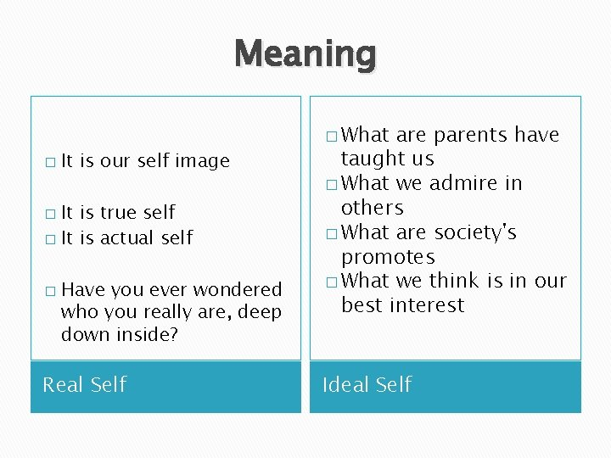
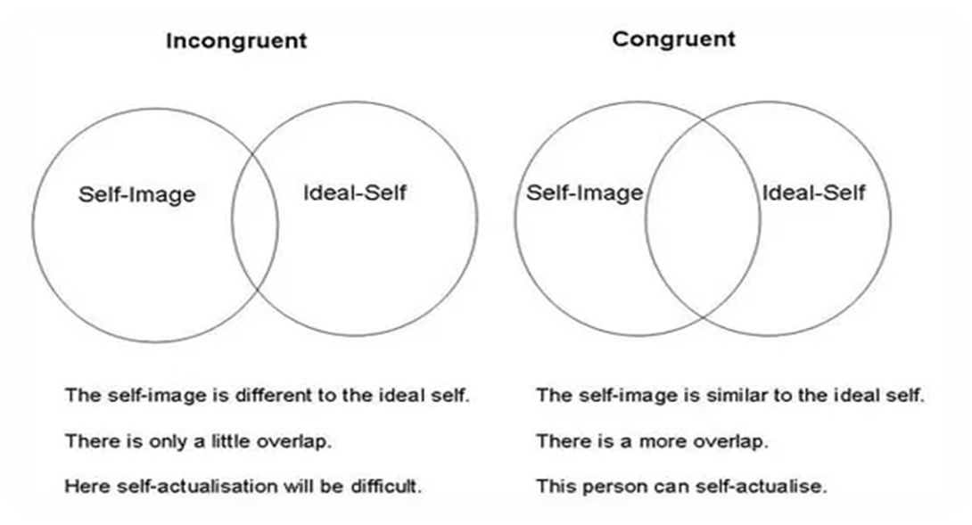

Slide 34
ACTIVITY
Five-factor model of personality
The Big Five Personality test, also known as the Five Factor Model, is a personality test based on the assumption that personality can be sufficiently described by five personality traits

Slide 35
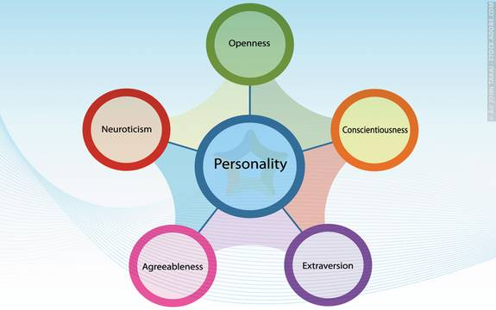
⁺ Five-factor model of personality
1. Extraversion: This trait includes characteristics such as excitability, sociability, talkativeness, assertiveness, and high amounts of emotional expressiveness.
2. Agreeableness: This personality dimension includes attributes such as trust, altruism, kindness, willingness to conform to group norms, affection, and other prosocial behaviors.
3. Conscientiousness: (Kon.shee.en.shuhs) Common features of this dimension include high levels of thoughtfulness, with good impulse control and goal-directed behaviors. Those high in conscientiousness tend to be organized and mindful of details.
4. Neuroticism: Individuals high in this trait tend to experience emotional instability, anxiety, moodiness, irritability, and sadness.
5. Openness: This trait features characteristics such as imagination and insight, and those high in this trait also tend to have a broad range of interests.

Slide 36
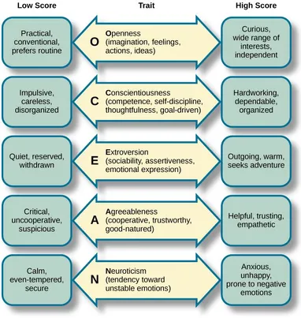

Slide 37
Summary of approaches
Psychoanalytic – sees personality as an aspect of self which is developed by childhood experiences (Freud )
Humanistic – sees personality as developed from a set of individual needs and motivation (Maslow and Rogers)

Slide 38
THANKS!

